Slide 1

Mall of Humanity: A Donation Drive
The Mall of Humanity was a community service project. It was initiated at FAST-NUCES Karachi. The project aimed to support the university's non-teaching staff during Ramadan. It fostered kindness and compassion among students.
Presented by Malik Zaryab Awan
Supervisor: Miss Asma Masood

Slide 2
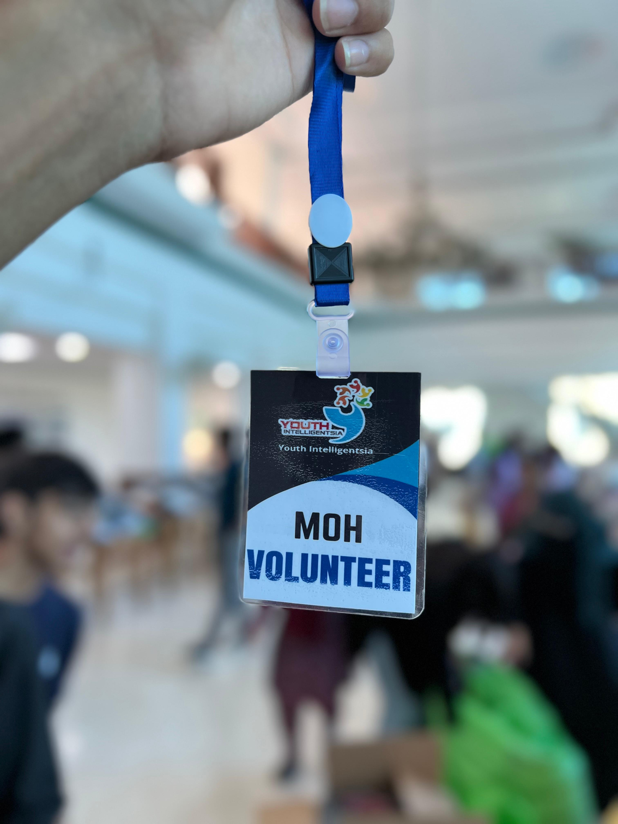
Project Objectives
1
Essential Support
Offer support to the university's support staff.
2
Student Engagement
Engage students in impactful community service.
3
Raise Awareness
Raise awareness about socioeconomic challenges.
4
Encourage Inclusivity
Uphold human values in line with SDGs.

Slide 3
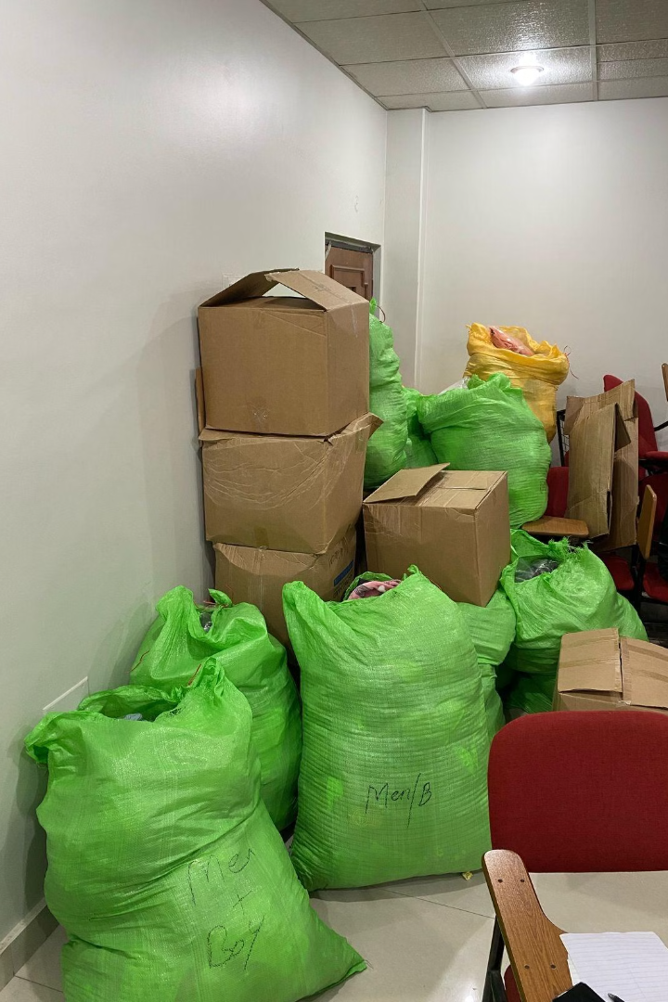




Implementation Phases
Collection Drive
Establish donation points and promote donations.
Sorting & Packaging
Organize donations into care packages.
Discreet Distribution
Distribute packages with respect and confidentiality.

Slide 4
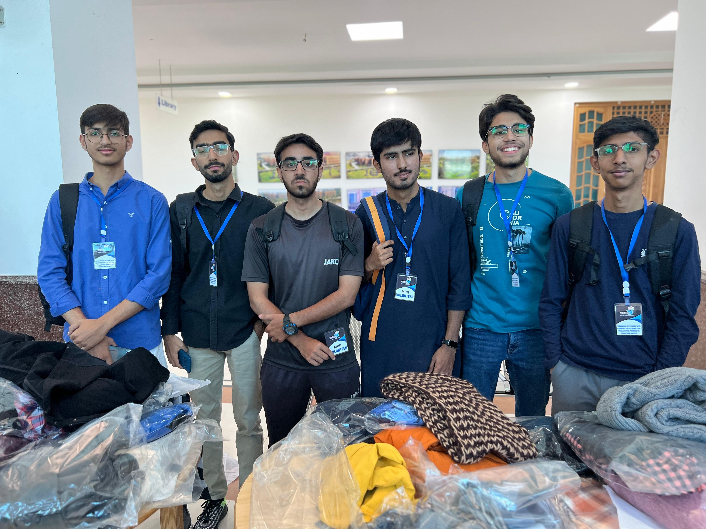
Volunteer Roles
Donation Collectors
Manage collection points and motivate student involvement.
Sorters & Packagers
Organize and package items with care and hygiene.
Distributors
Deliver items discreetly, preserving confidentiality and dignity.

Slide 5
Alignment with UN SDGs
SDG 1: No Poverty
SDG 10: Reduced Inequalities
Alleviated hardship by providing basic necessities.
Promoted inclusivity within the university.
SDG 2: Zero Hunger
SDG 11: Sustainable Communities
Distributed food items to ensure food security.
Fostered a supportive community culture.

Slide 6
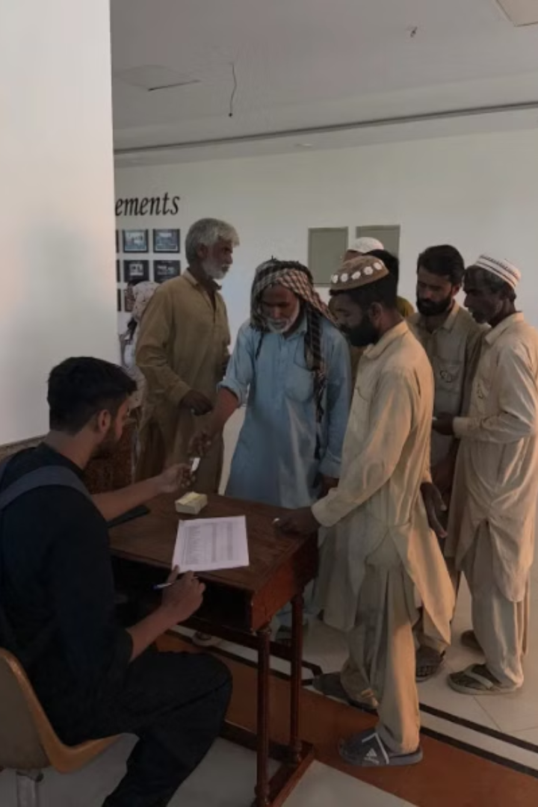



Project Impact
Direct Relief
Provided immediate support to university staff.
Active Participation
Engaged students in organizing and managing the initiative.
Increased Empathy
Raised social awareness among student volunteers.

Slide 7



Long-Term Impact
Established Blueprint
Created a model for future donation drives.
Fostered Engagement
Promoted community engagement and human values.
Inspired Students
Encouraged students to serve beyond academics.

Slide 8
Conclusion
The Mall of Humanity was an impactful initiative. It brought students and staff together. It embodied the spirit of Ramadan. It upheld values in the university community. It set the foundation for potential future editions.
THANK YOU, JAZAK ALLLAH

